Slide 1
IBM API Connect Overview

Slide 2
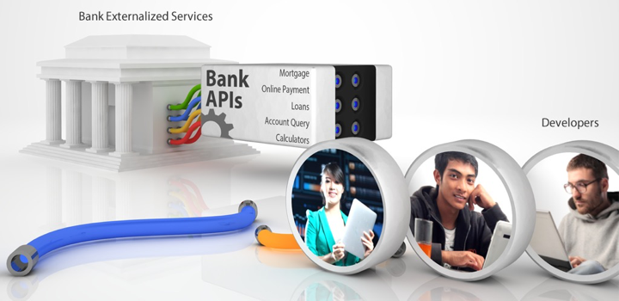
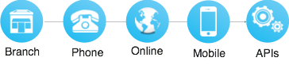
API’s – the building block for apps
APIs represent a new, fast growing channel opportunity

Slide 3
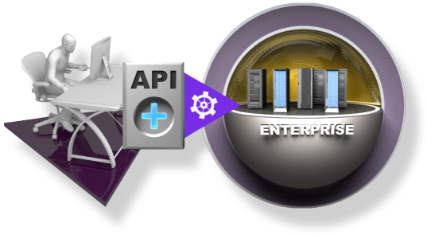
The Business of APIs
What is a Business API?
A Business API is a public persona for an enterprise; exposing defined assets, data or services for public consumption
No business logic.
A Business API is simple for app developers to use, access and understand
A Business API can be easily invoked
What Value Does a Business API Provide?
Extends an enterprise and opens new markets by allowing external app developers to easily leverage, publicize and/or aggregate a company’s assets for broad-based consumption
What “assets, data or services”
are exposed via a Business API?:
Product catalogs
Store listings
Order status
Inventory
Payment Services
ATM / retail and other Locations
Credit History / Credit Check

Slide 4



The Business of APIs
Public, Open-To-All APIs
Protected, Open-To-Partner APIs
Private, Internal APIs
APIs are open to any developer who wants to sign up
Apps are more targeted towards end consumers
The business driver is to engage customers through external developers
APIs are open to select business partners
Apps could be targeted at end consumers or business users
The business driver is usually different, based on the data and type of business of the enterprise
APIs are exposed only to existing developers within the enterprise
Apps are usually targeted at employees of the enterprise
The business driver is more around productivity of employees
Notes:
On one side, you have your traditional infrastructure with your data and systems that make your organization unique On the other, you need to be quick and nimble to react rapidly to market changes. Learn by doing, deliver rapidly & frequently, fail fast, try again….

Slide 5




API Economy Value Chain
To Develop Innovative Apps
Exposed as APIs
www
TH
GS
IN
Existing Enterprise IT Investments
Self Service Consumed by Developers
Delivering Differentiated B2C, B2B, B2E Experiences

Slide 6
Digital Transformation through Multi-Speed IT
Fast
Speed
Digital
Ecosystem
Speed & Agility
Core Enterprise
Integration & Scale
Steady Speed
Notes:
On one side, you have your traditional infrastructure with your data and systems that make your organization unique On the other, you need to be quick and nimble to react rapidly to market changes. Learn by doing, deliver rapidly & frequently, fail fast, try again….
מנוע צמיחה

Slide 7
Challenges with Multi-Speed IT
Fast
Speed
How to rapidly create APIs from existing data sources?
How to manage the consumption of APIs across the enterprise?
How to provide self-service for internal & external developers?
How to enforce security at runtime?
How to throttle and provide controlled access?
How to introduce change with new versions?
How do I know who is using my service and how much?
How much should I charge for access to my service?
Digital
Ecosystem
Speed & Agility
Core Enterprise
Integration & Scale
Steady Speed
Notes:
As enterprises progress their digital transformation journey in a multi-speed IT environment, the challenge is to rapidly expose business data and assets as APIs, publish those APIs in a secure, controlled & managed fashion while gaining insights into their usage and ensuring a self-service developer experience for API Consumers. IBM API Connect offering solves that exact challenge by providing a single, comprehensive API solution to create, run, manage, secure, socialize & analyze APIs and Microservices to allow organizations to participate in the API Economy.

Slide 8

An API Strategy To…
1
2
3
4
Speed application development
Via self service library of reusable APIs
Securely expose systems of record
Apps and data to Mobile, IoT, & hybrid cloud apps
Publish APIs to expand brand reach
Tap into developer & partner ecosystems
Enable new business
Monetize existing and new data & algorithms

Slide 9


Simplified & Comprehensive API foundation
Create
Run
Secure
Manage

Slide 10
Simplified & Comprehensive API foundation
What is API Connect?
An integrated creation, runtime, management, and security foundation for enterprise grade API’s and Microservices to power modern digital applications
What does API Connect provide?
Automated, visual and coding options for creating APIs
Node.js and Java support for creating Microservices
Integrated enterprise grade clustering, management and security for Node.js and Java
Lifecycle and governance for APIs, Products and Plans
Access control over API’s, API Plans and API Products
Advanced API usage analytics
Customizable, self service developer portal for publishing APIs
Policy enforcement, security and control
Create
Run
Secure
Manage

Slide 11

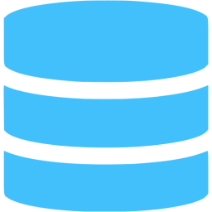


Already Have APIs?
Secure
Manage
Secure
Manage
Secure
Manage
System API
System API
System API
System API
System API
System API
Web Service
Web Service
ESB
ESB
Added Management & Security to protect enterprise assets
Companies already have web services, which can be exposed as APIs
Software vendors are adding API support to existing products to pass through data from a system of record unchanged; aka System APIs
Vs.
System APIs should be managed and secured to protect enterprise systems:
Where are they published? Which developers can discover them? Which applications can access them? How frequently? At what cost? Etc…

Slide 12
API Connect Platform
Developer Portal
For app developers (API consumers)
For API owners, developers, business users (API providers)
API Manager
API Gateway
Enforce runtime policies to secure & control API traffic
For developers to create, test APIs locally & DevOps to automate API tasks
Developer Toolkit
For operations, unified ops & mgmt for Node & Java runtimes
Compute Runtime Manager
Execute API & Microservices business logic in Node & Java
Compute Runtime

Slide 13








IBM API Connect: Where does it fit?
Consumer
(Systems of Engagement)
Provider
(Systems of Record)
Dev Portal
Manage
API Discovery API, Plan, Product, Policy Creation API, Plan, Product Version & Lifecycle Management Self-service App Developer Portal API Monitoring & Analytics Subscription & Community Management
Create & Run (Node / Java)
Develop & Compose Microservices Connect Microservices to data sources Build, deploy, scale Microservices Monitor & debug Microservices Unified Node & Java Runtime Mgmt
External App Developer
Partner App Developer
Internal App Developer
APIC managed Microservices Traffic
Data Store
Mobile & Web Apps
Business Partner Apps
Cloud Service
API Gateway
API Traffic
Application Server
Secure
API Policy Enforcement Enterprise Security Traffic control & mediation Workload optimization Monitoring/Analytics Collection
Enterprise Internal Apps
Internet of Things
ESB / Middleware
z System / Legacy Apps
Deployment Options:
Bluemix Public, Bluemix Dedicated
On Premises or Customer Cloud

Slide 14
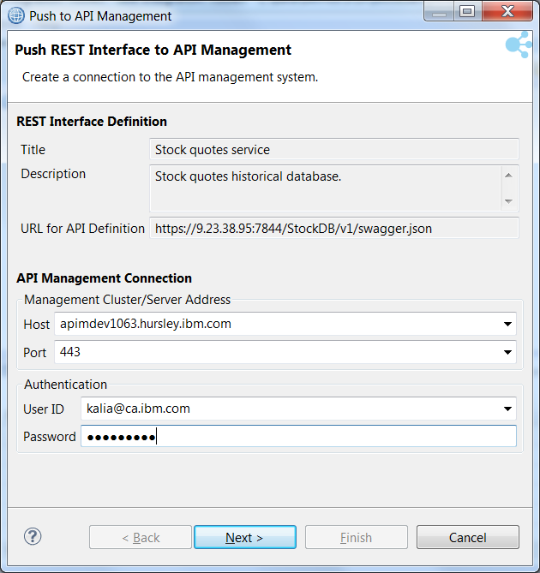
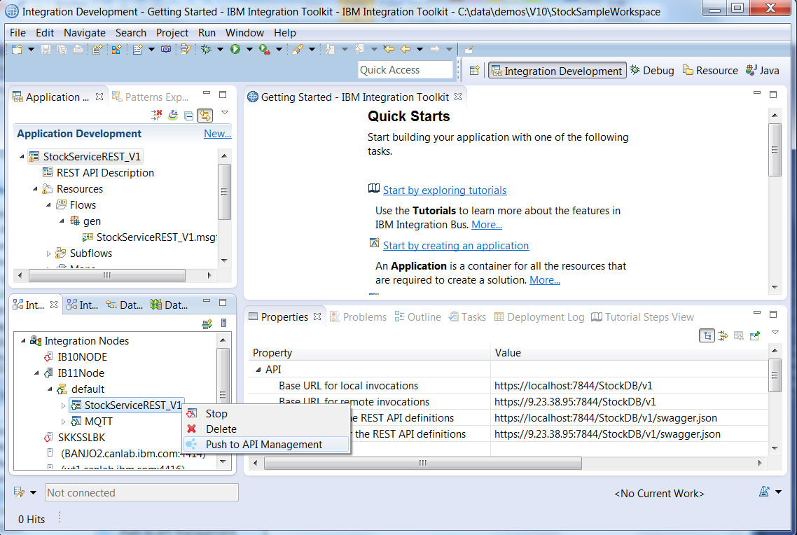
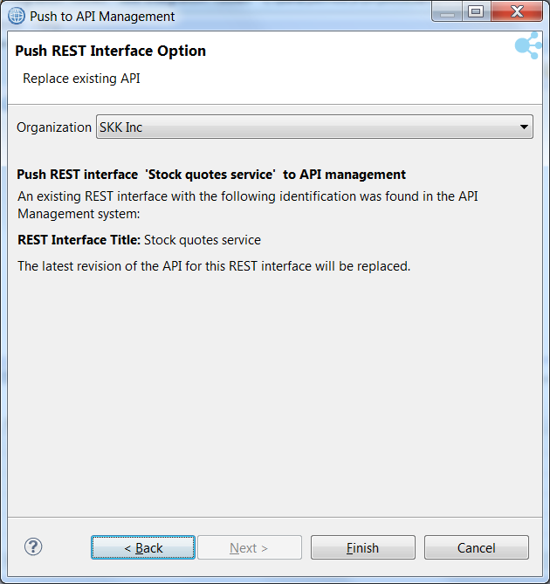
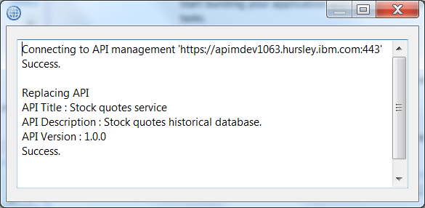
IBM Integration Bus* & API Connect integration Take your enterprise APIs and share it with app developers – in a controlled, managed & secure way
Push REST interface to API Connect from IIB Integration node view
IBM Integration Bus toolkit view

Slide 15
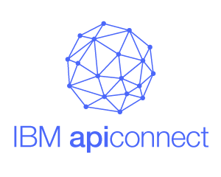
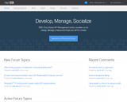
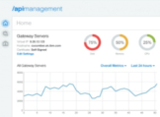
z/OS Connect & API Connect integration Extend your z/OS reach – fast & secure with enforced rate limits
CICS
Services on
z/OS Connect
IMS
Services on
Management + Runtime gateway enforcement
Systems of Engagement
Systems of Record
Welcome to the API Portal
Developer portal
API analytics
Discover existing transactions/services in CICS & IMS environments
Securely & easily expose existing z/OS transactions as REST & SOAP APIs (with z/OS Connect)
Provide self-service & social experience to API consumers on a built-in developer portal
Enforce runtime rate limits, and throttle impact to z/OS systems
Manage API subscribers with API lifecycle & Analyze API usage

Slide 16
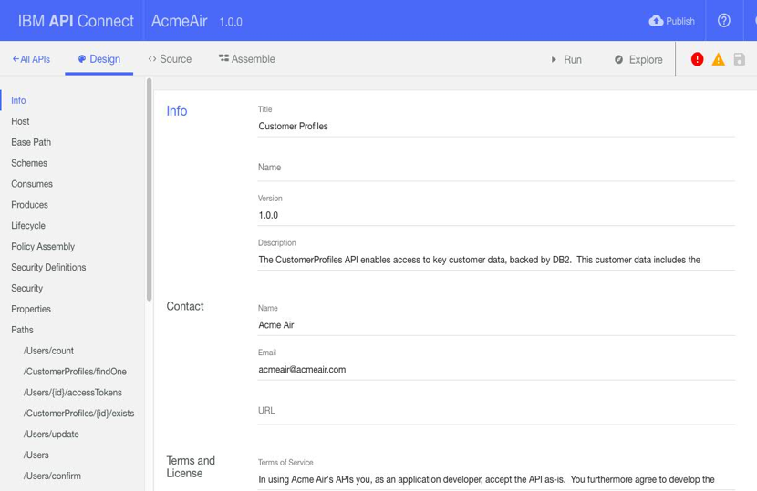
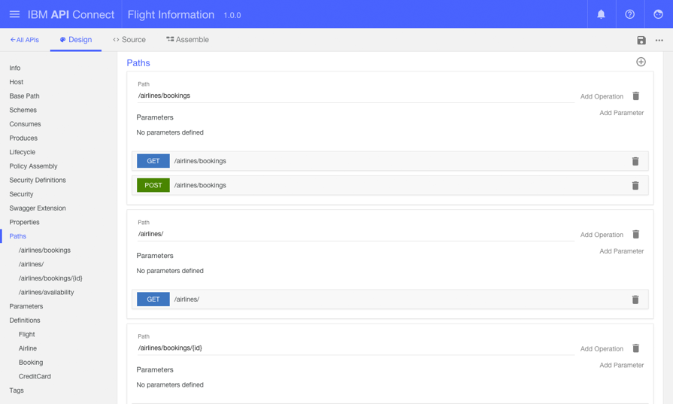
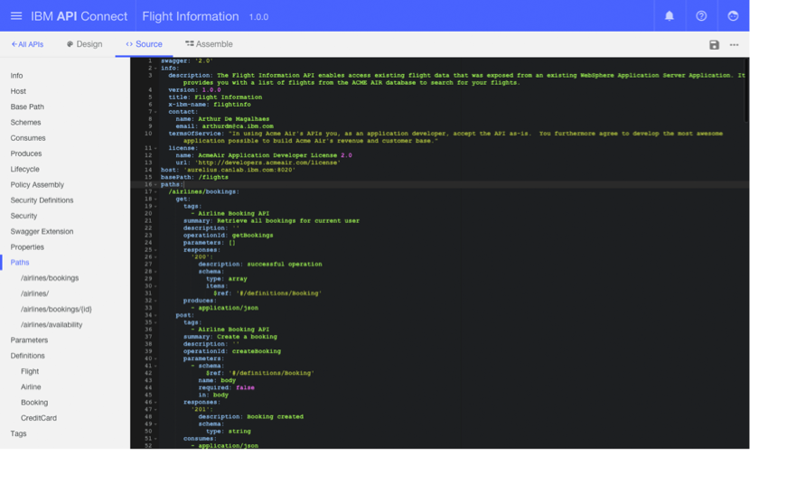
View / Update auto generated API definitions

Slide 17
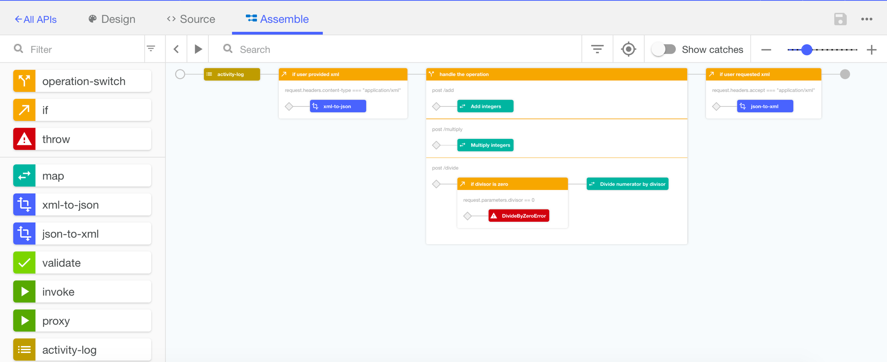
Graphically assemble policies to the API
REPEAT, replace if necessary,

Slide 18
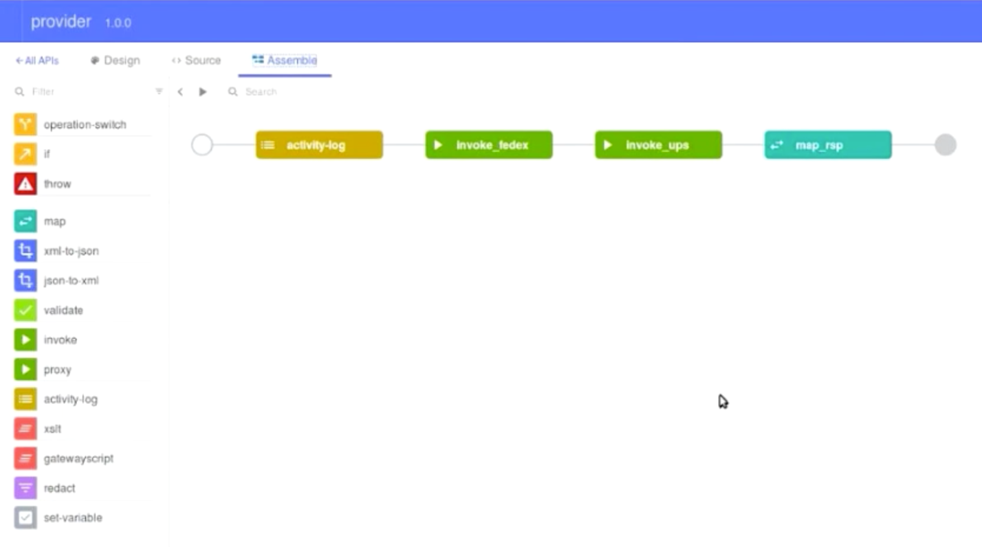
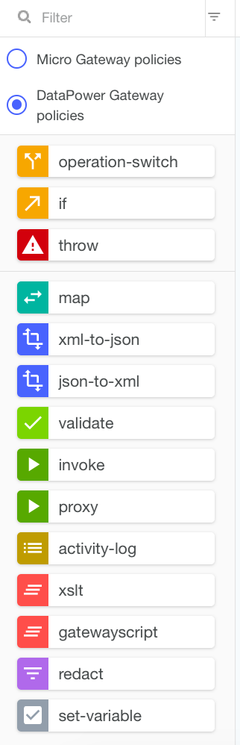
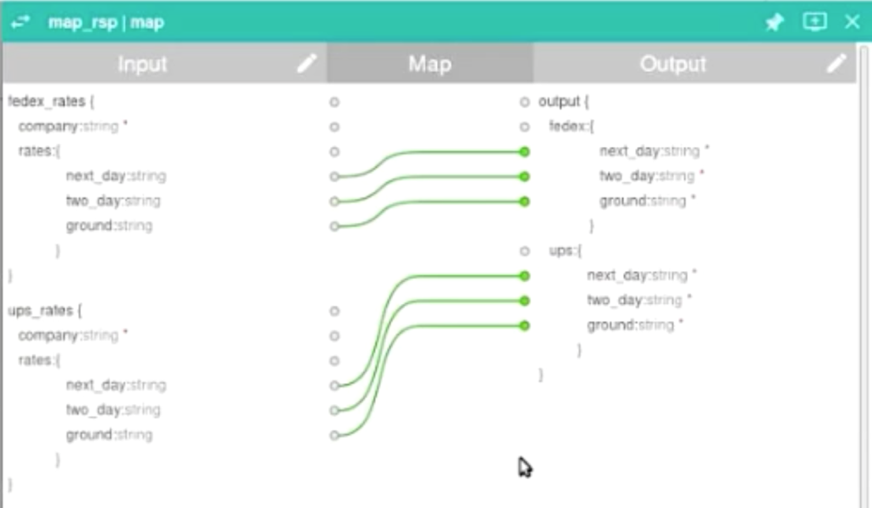
Advanced Mapping policy

Slide 19
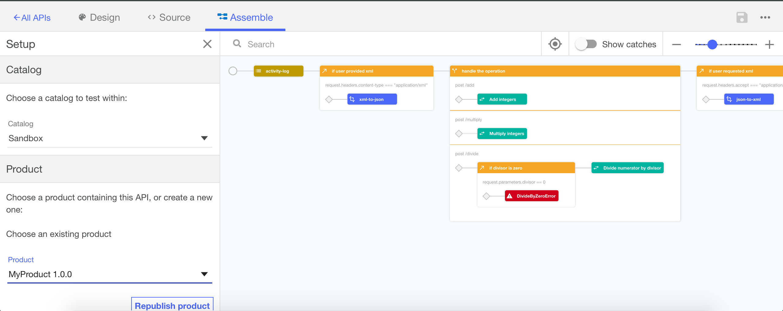
Quickly publish and test your assembly flow

Slide 20
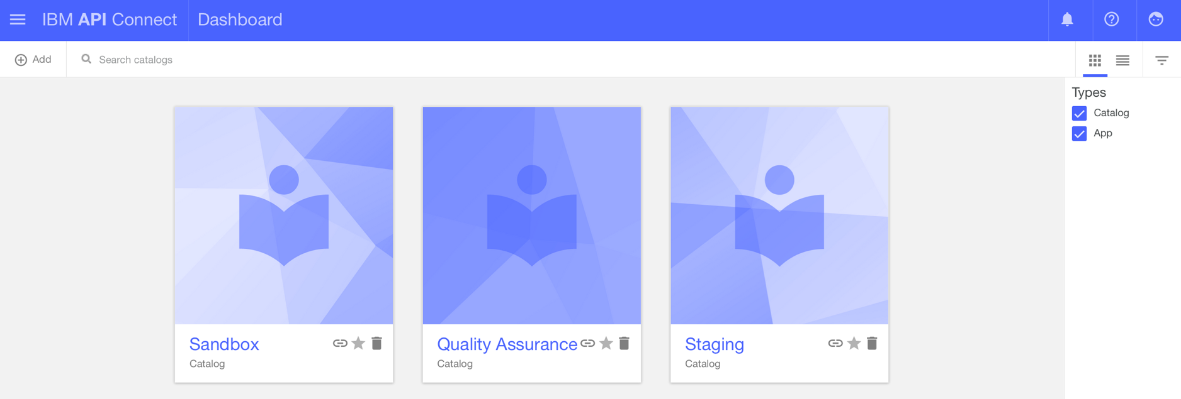
Create multiple catalogs & promote APIs across them

Slide 21
Analytics Capabilities
Analytics for both API provider and application developer
API Connect Essentials & Professional include Analytics,
API Connect Enterprise includes Advanced Analytics
Enables chargeback or billing for API consumption
Advanced Analytics
Based on API Invocation metrics
+
API headers (request & response)
API payloads (request & response)
Analytics
Based on API Invocation metrics
Date & Time
API Consumer App
API User
Developer Org
API
Operation
Plan & Product
Catalog
API Provider
API Req & Rsp Size
API Latency Info.
API Call Status
Enables deeper insights via the use of custom queries against API header and payload data
All transfers over $5000
Black T-shirts sold last week
Analytics Examples:
Most active APIs
Most active applications
Analyze call volumes/response times across date range, developer org, Products, Plans, APIs, operations, catalogs
View individual call activity details

Slide 22
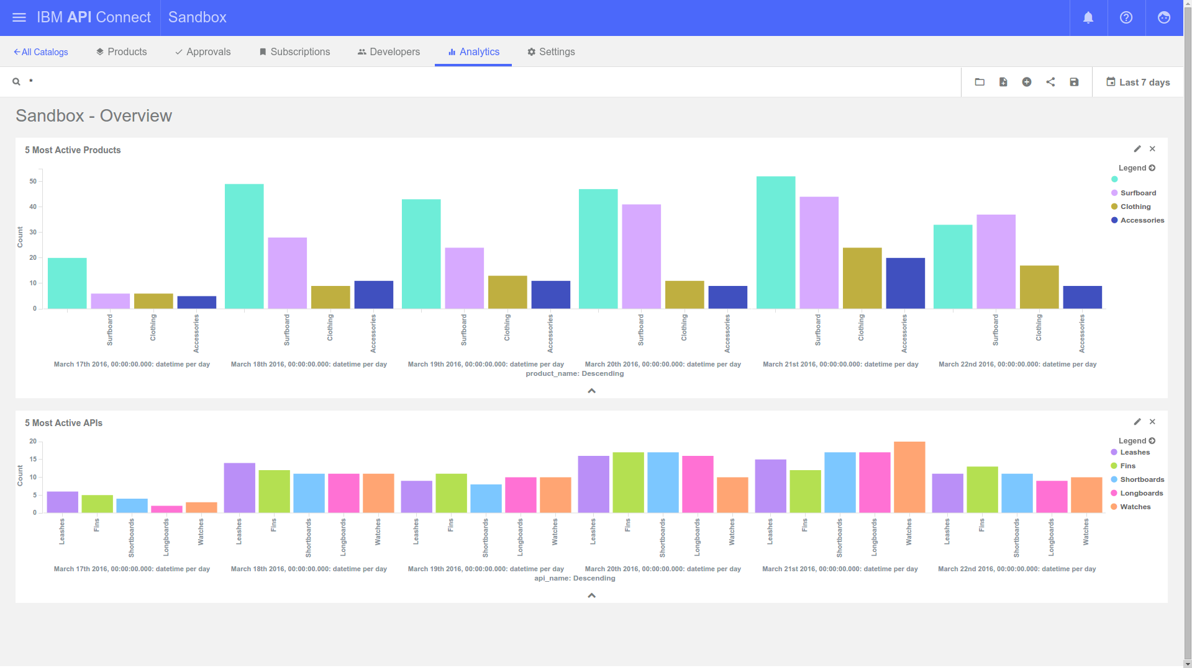
Understand the most active APIs and Products

Slide 23
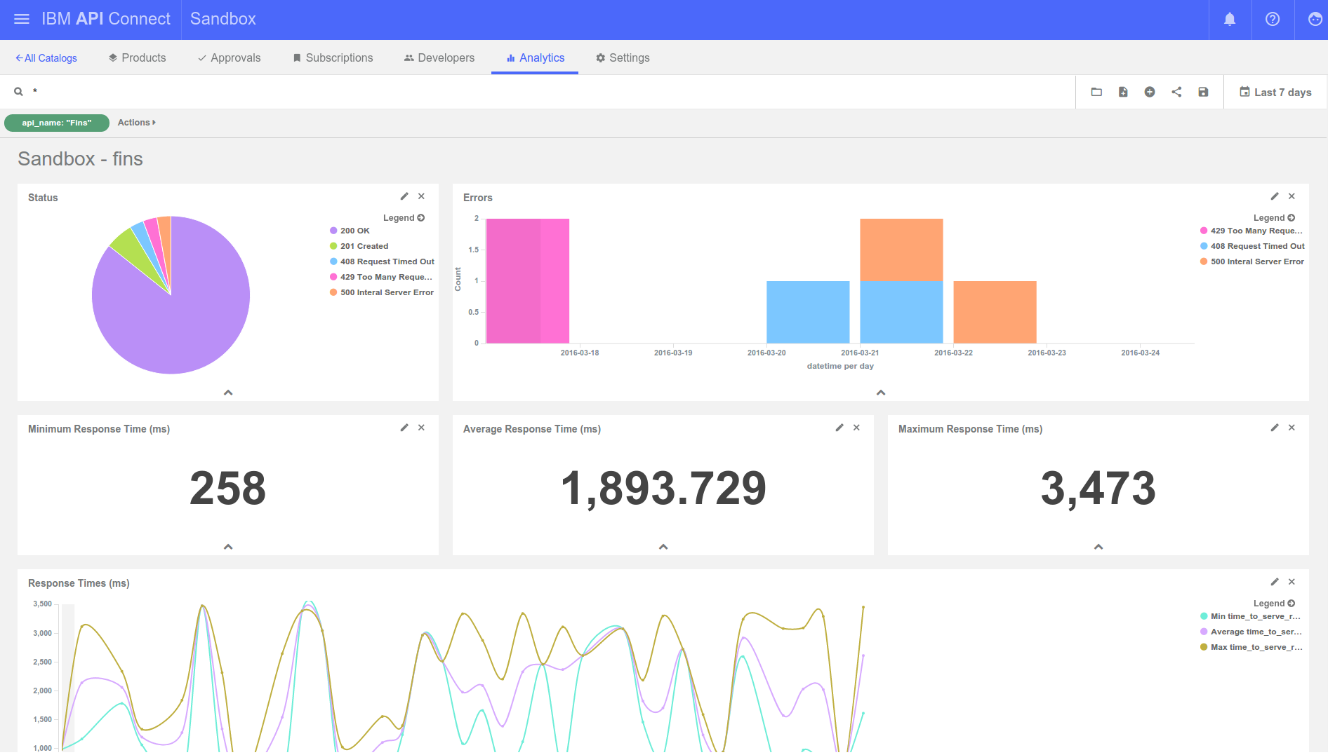
Analyze error rates & response times to understand SLA

Slide 24
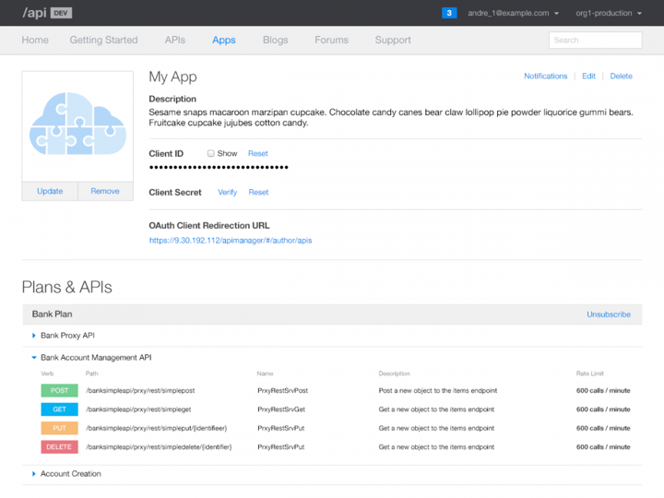
Developer portal for API consumers
Customizable content management system
Browse API documentation
Code snippets for popular programming language
Browse available plans with limits and choose from available plans
Test APIs as consumer
Analytics Capabilities for API consumers
App registration and subscription
Forums, Blogs and Support content
Self service developer portal to explore

Slide 25
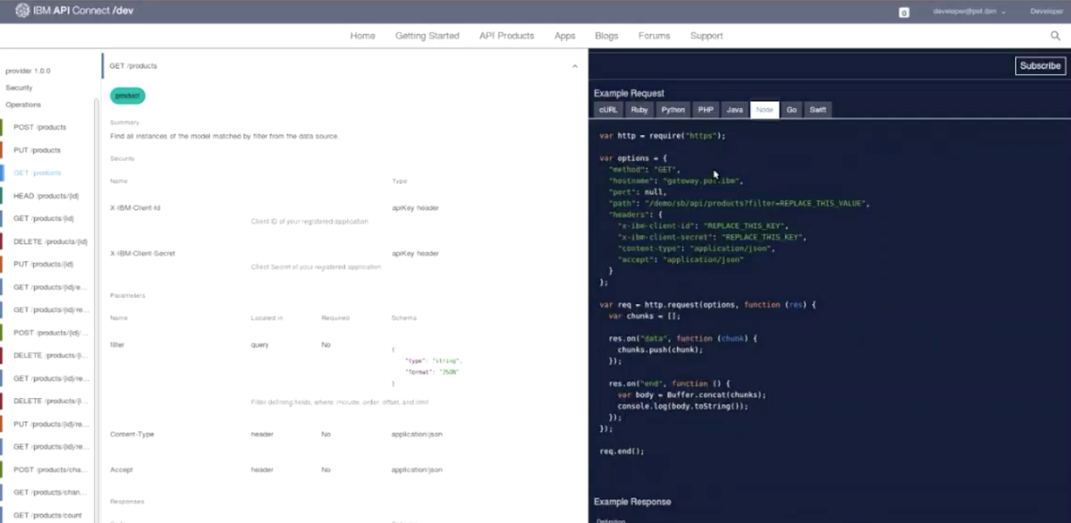
Developer portal for API consumers

Slide 26



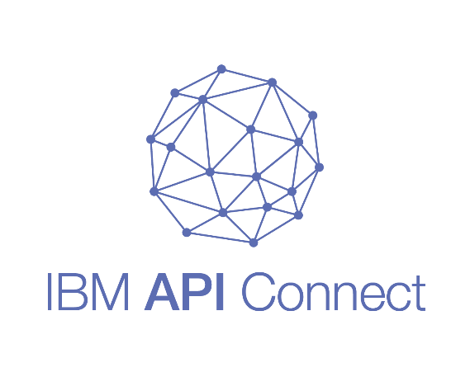
API Connect: Flexible Packaging
Deployment | Deploy where it’s most convenient for you Deploy on IBM Bluemix Deploy to 3rd party clouds Deploy on-premises
Licensing | Pay only for what you need Subscription (API calls/month) Perpetual (per PVU, unlimited API calls)
Used mixed deployments for greater flexibility:
Deploy an API from on-premises development environments to off-premises staging/production environments
Subscription entitlements (API calls/mo) can be split over multiple API Connect instances

Slide 27
Capabilities Delivered
Rapid model-driven API creation
Datasource to API mapping automation
Standards-based visual API spec creation in Swagger 2.0
Local API creation and testing
On-cloud & on-premises staging of APIs, Plans & Products
Node.js & Java Microservice runtime
Node.js & Java integrated runtime management
Enterprise HA & scaling
On-cloud & on-premises staging of Microservice applications
Create
Run
Policy enforcement
Enterprise security
Quota management & rate limiting
Content-based routing
Response caching, load-balancing and offload processing
Message format & transport protocol mediation
API discovery
API, Plan & Product policy creation
API, Plan & Product lifecycle mgmt.
Self-service, customizable, developer portal
Advanced Analytics
Subscription & community mgmt.
Secure
Manage

Slide 28


THANK YOU
Bookmark this  ibm.biz/apiconnect

Slide 29
Grows with your Business Needs
Enterprise
For cross-organization projects
Professional
For single API projects
Deploy where it’s most convenient for you Deploy on IBM Bluemix Deploy to 3rd party clouds Deploy on-premises
Essentials
Free for developers

Slide 30
Developer Toolkit for creating and testing API & Microservices on your laptop

Slide 31
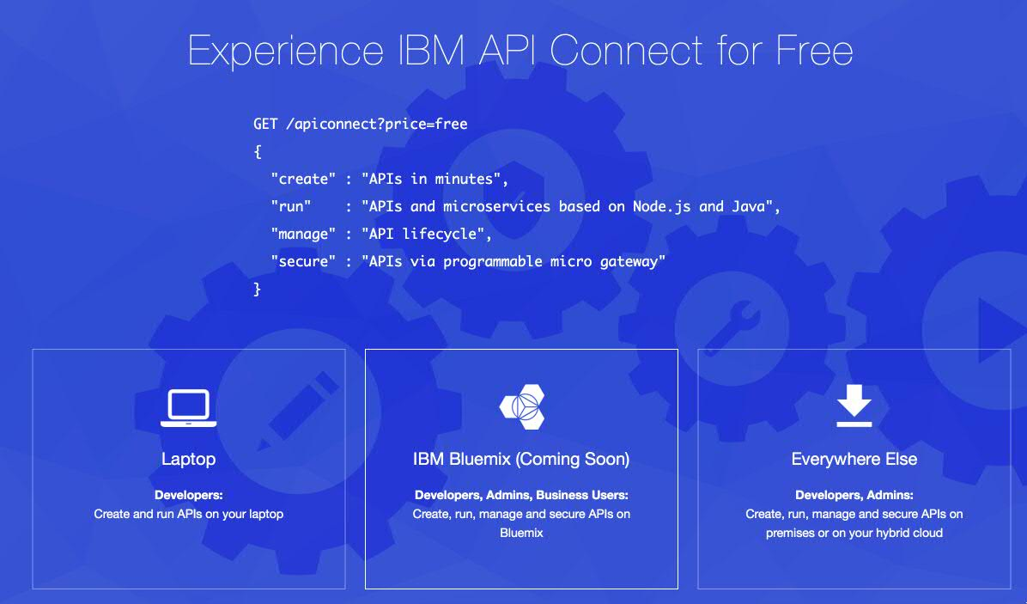
Developer Toolkit – Laptop Experience (API Designer)
Start at developer.ibm.com/apiconnect

Slide 32
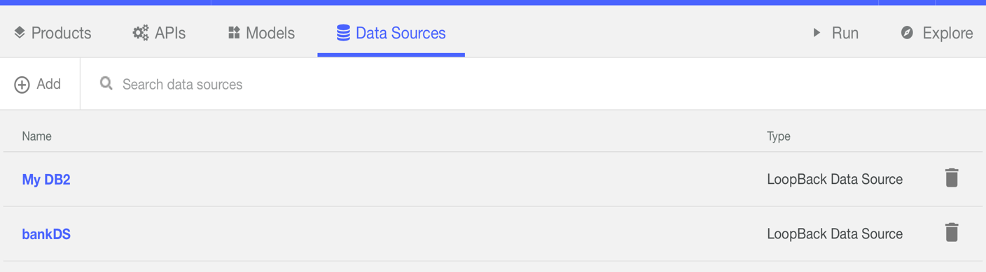
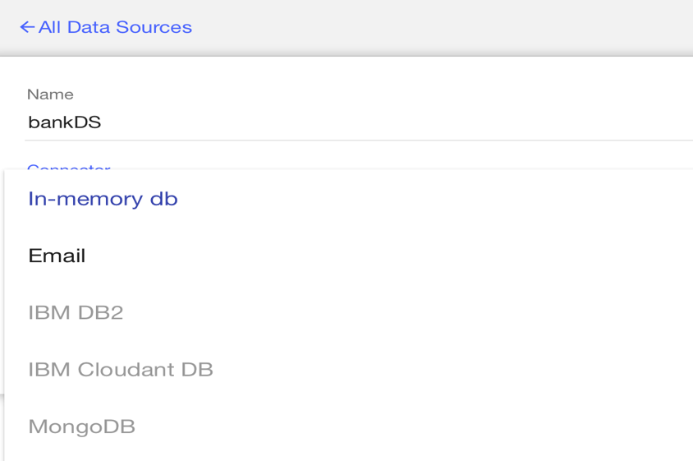
Connect to wide variety of Systems of Records using Loopback Connectors

Slide 33
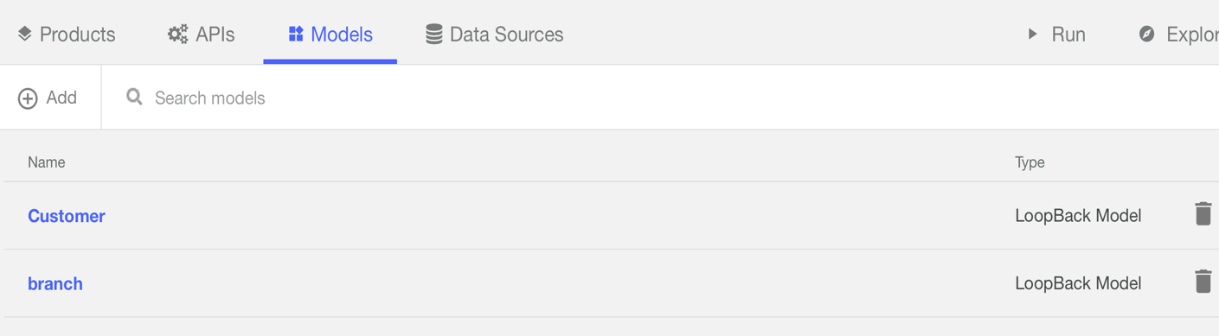
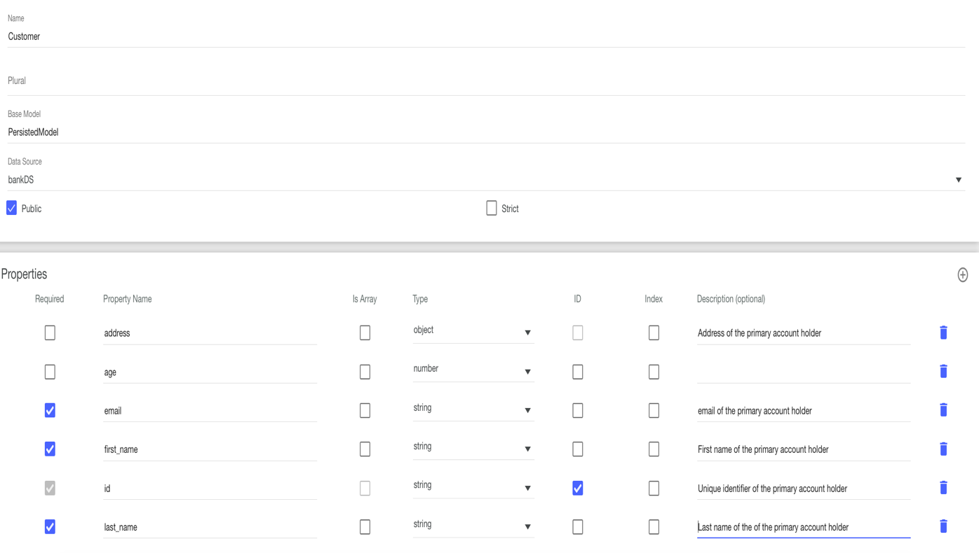
Rapidly create model definitions for your APIs

Slide 34
View / Update auto generated API definitions

Slide 35
Graphically assemble policies to the API for Enforcement

Slide 36
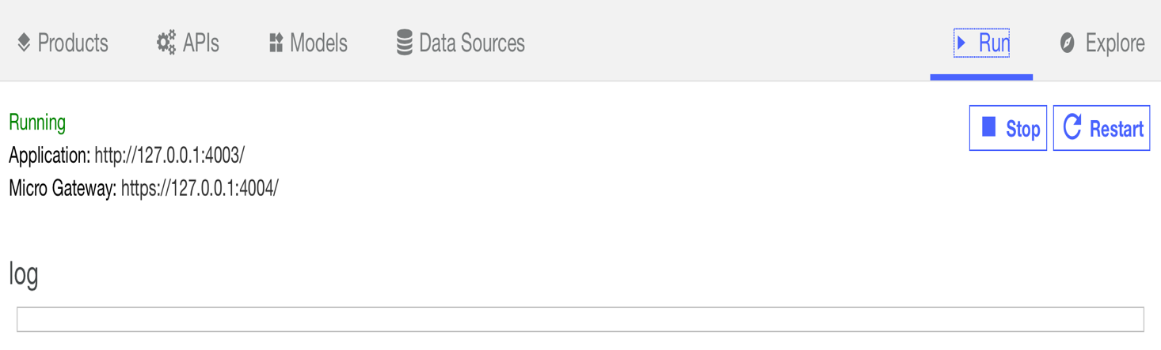
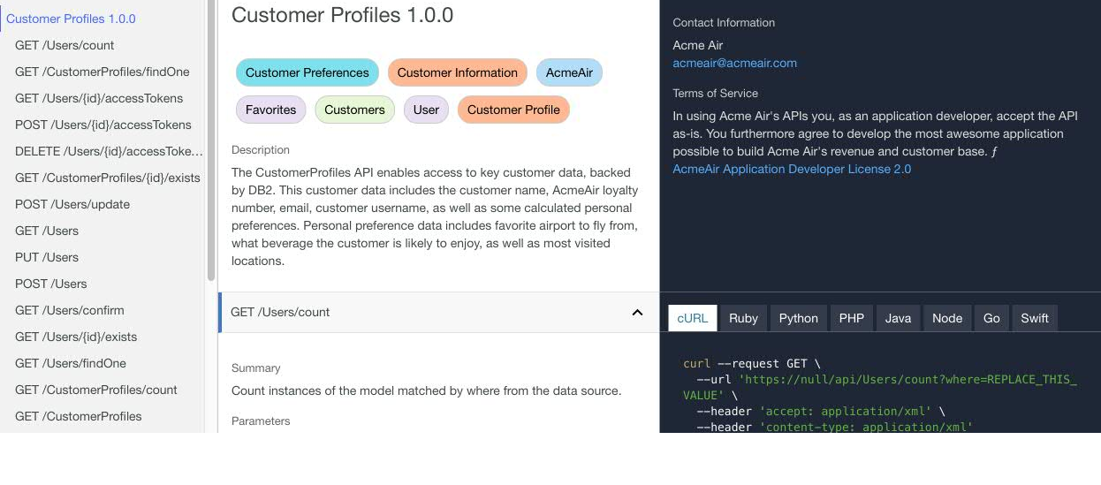
Run Loopback Microservice and Test the API

Slide 37
API Manager console for API providers

Slide 38
Create multiple catalogs & promote APIs across them

Slide 39
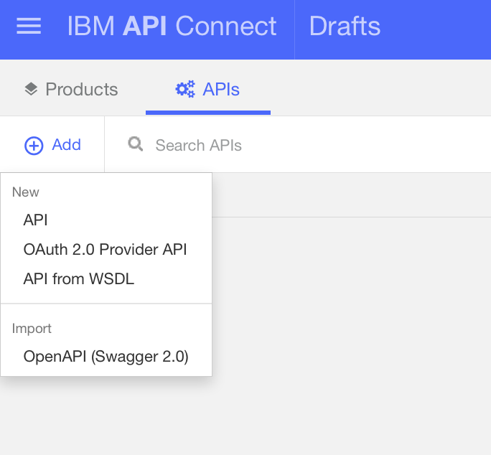
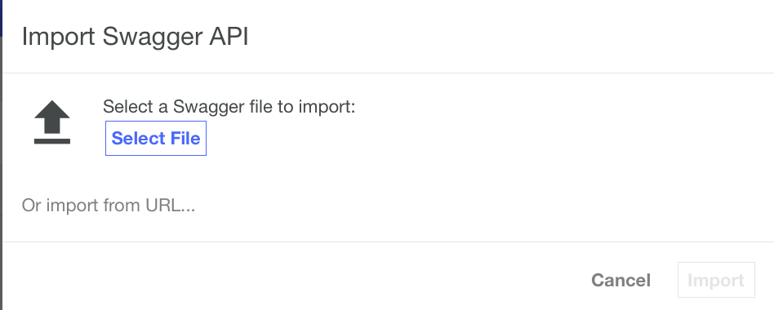
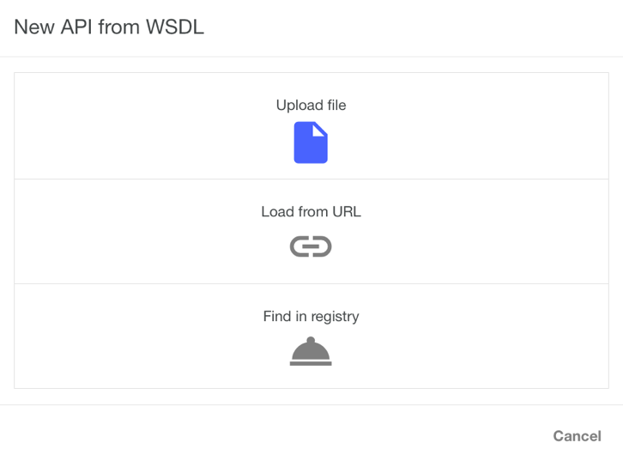
Import existing Swagger or SOAP definition or define a brand new API

Slide 40
API Policy Management using graphical & source views

Slide 41
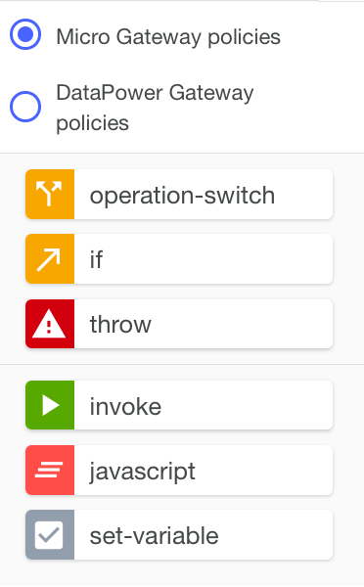
Host of policies to support Micro Gateway & Datapower Gateway

Slide 42
REPEAT, replace if necessary,
Graphically assemble policies to the API for Enforcement

Slide 43
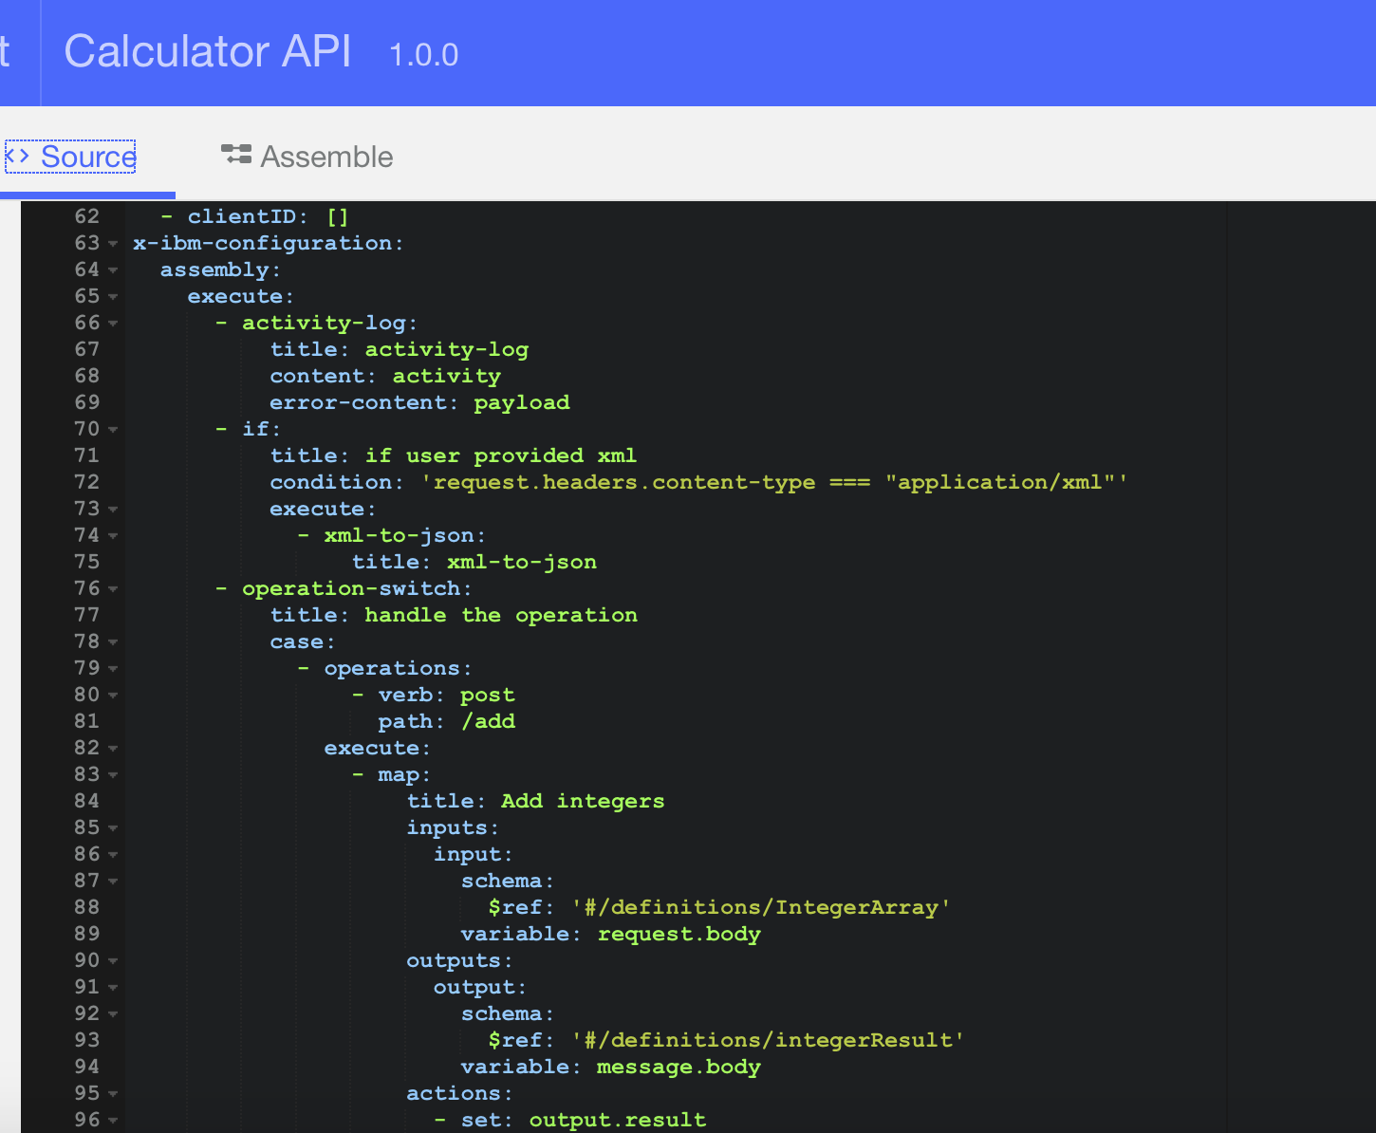
Flexibility to add / update assembly directly as Swagger Extensions

Slide 44
Quickly test your assembly flow right from the

Slide 45
API Packaging

Slide 46
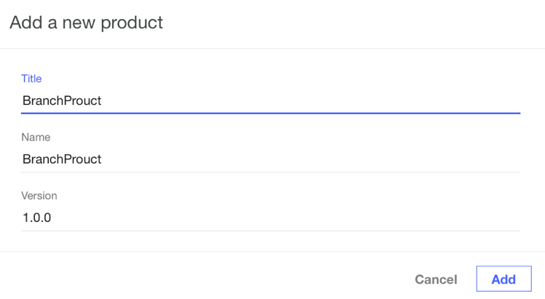
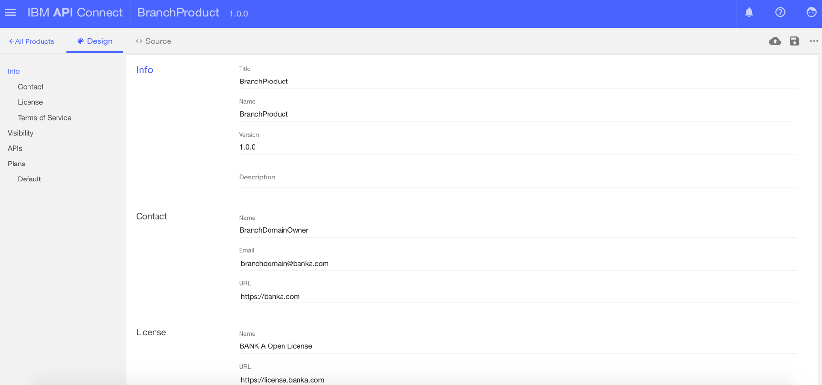
Package & Productize APIs by creating Products and offer them to API Consumers

Slide 47
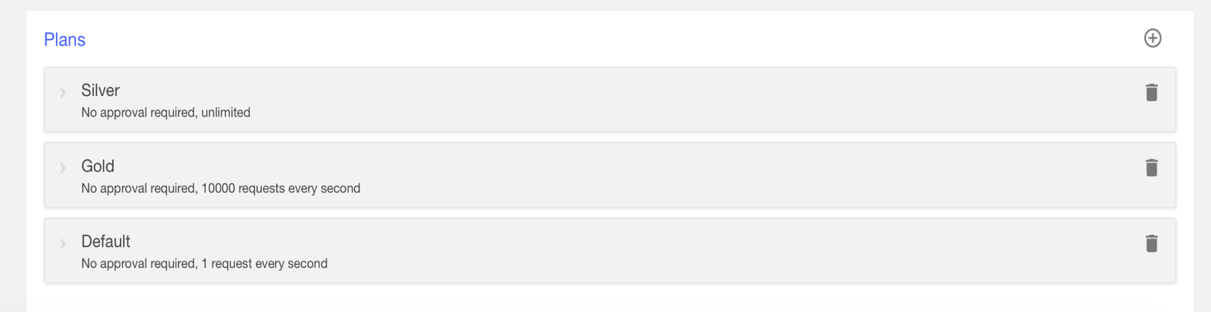
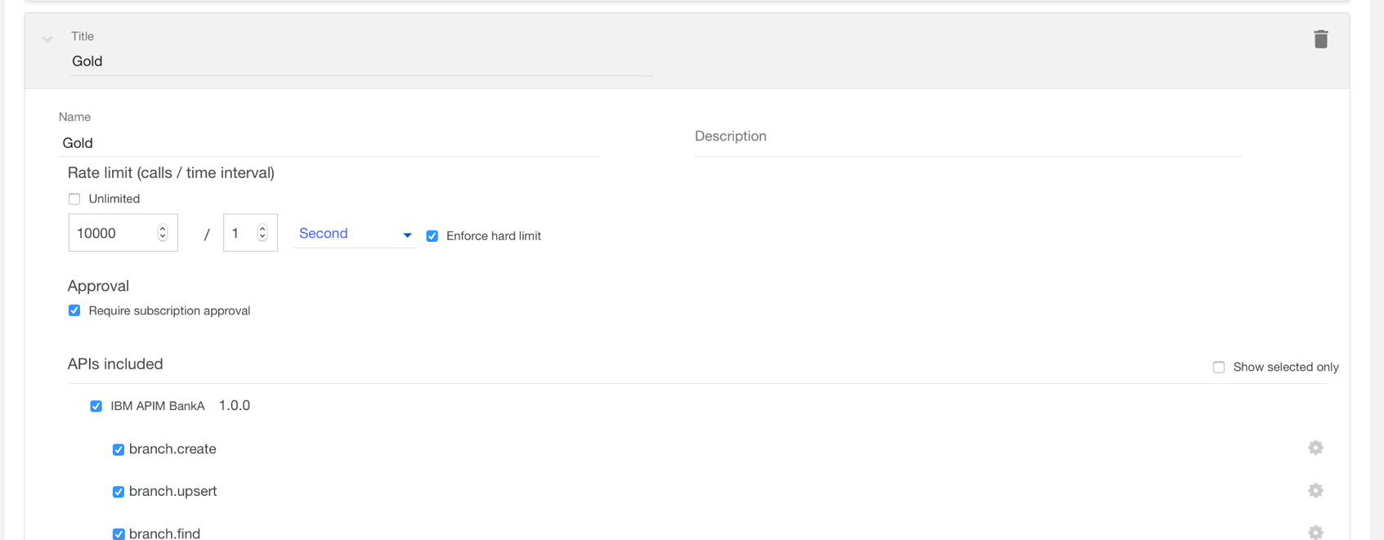
Offer those Products through various Plans & apply rate limits for consumption

Slide 48
Lifecycle Management, Plan Visibility & Subscription Management

Slide 49
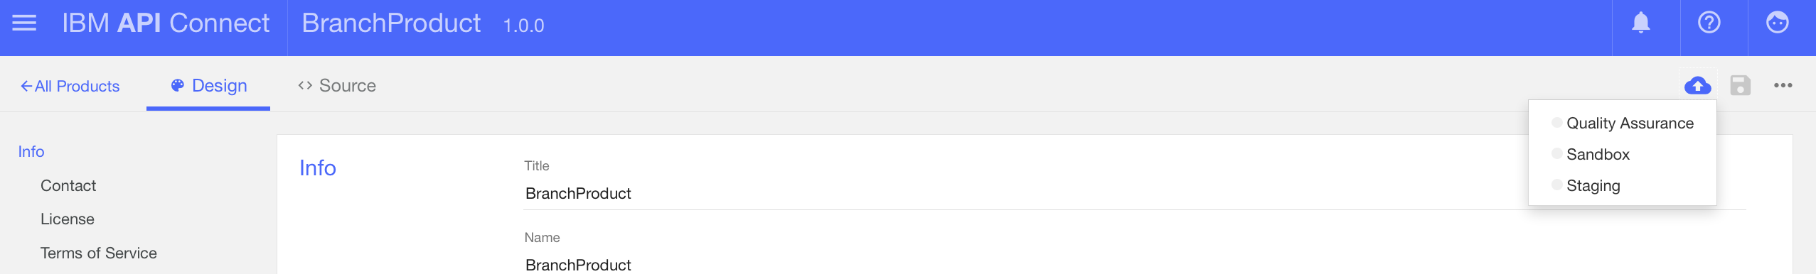
Stage products to catalog of choice

Slide 50
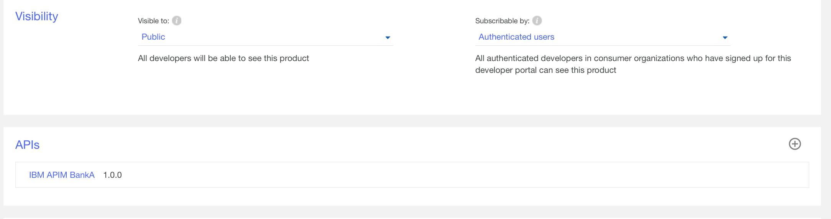
Control Visibility & Subscribability of the API

Slide 51
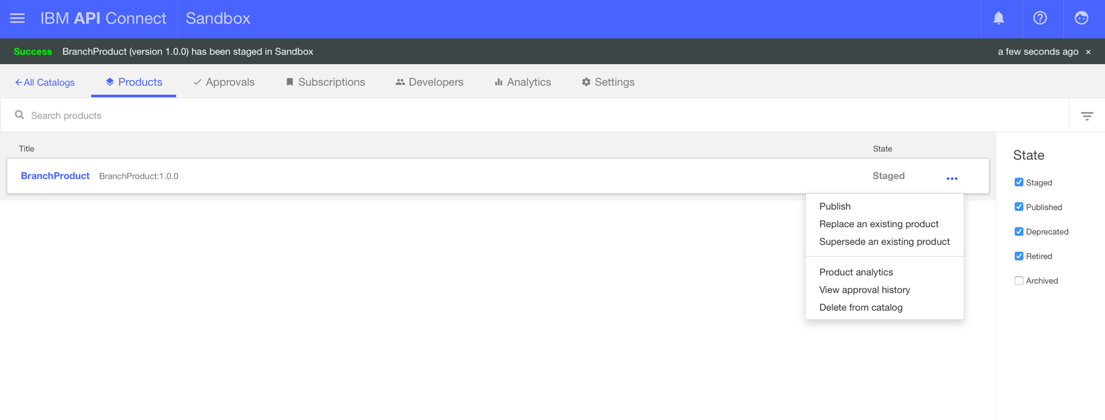
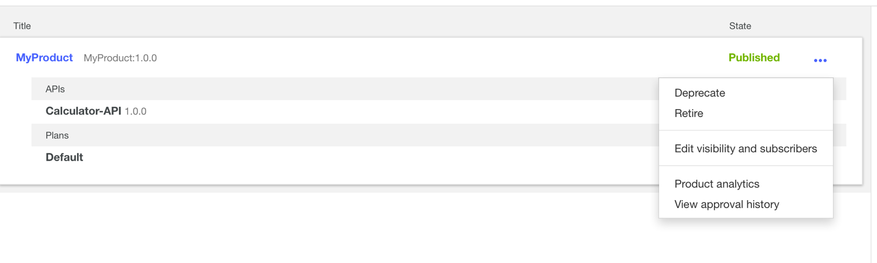
Manage Lifecycle of the API

Slide 52
API Provider user management

Slide 53
Analytics

Slide 54
Analyze & understand the most active APIs and Products

Slide 55
Analyze error rates & response times to understand SLA adherence

Slide 56
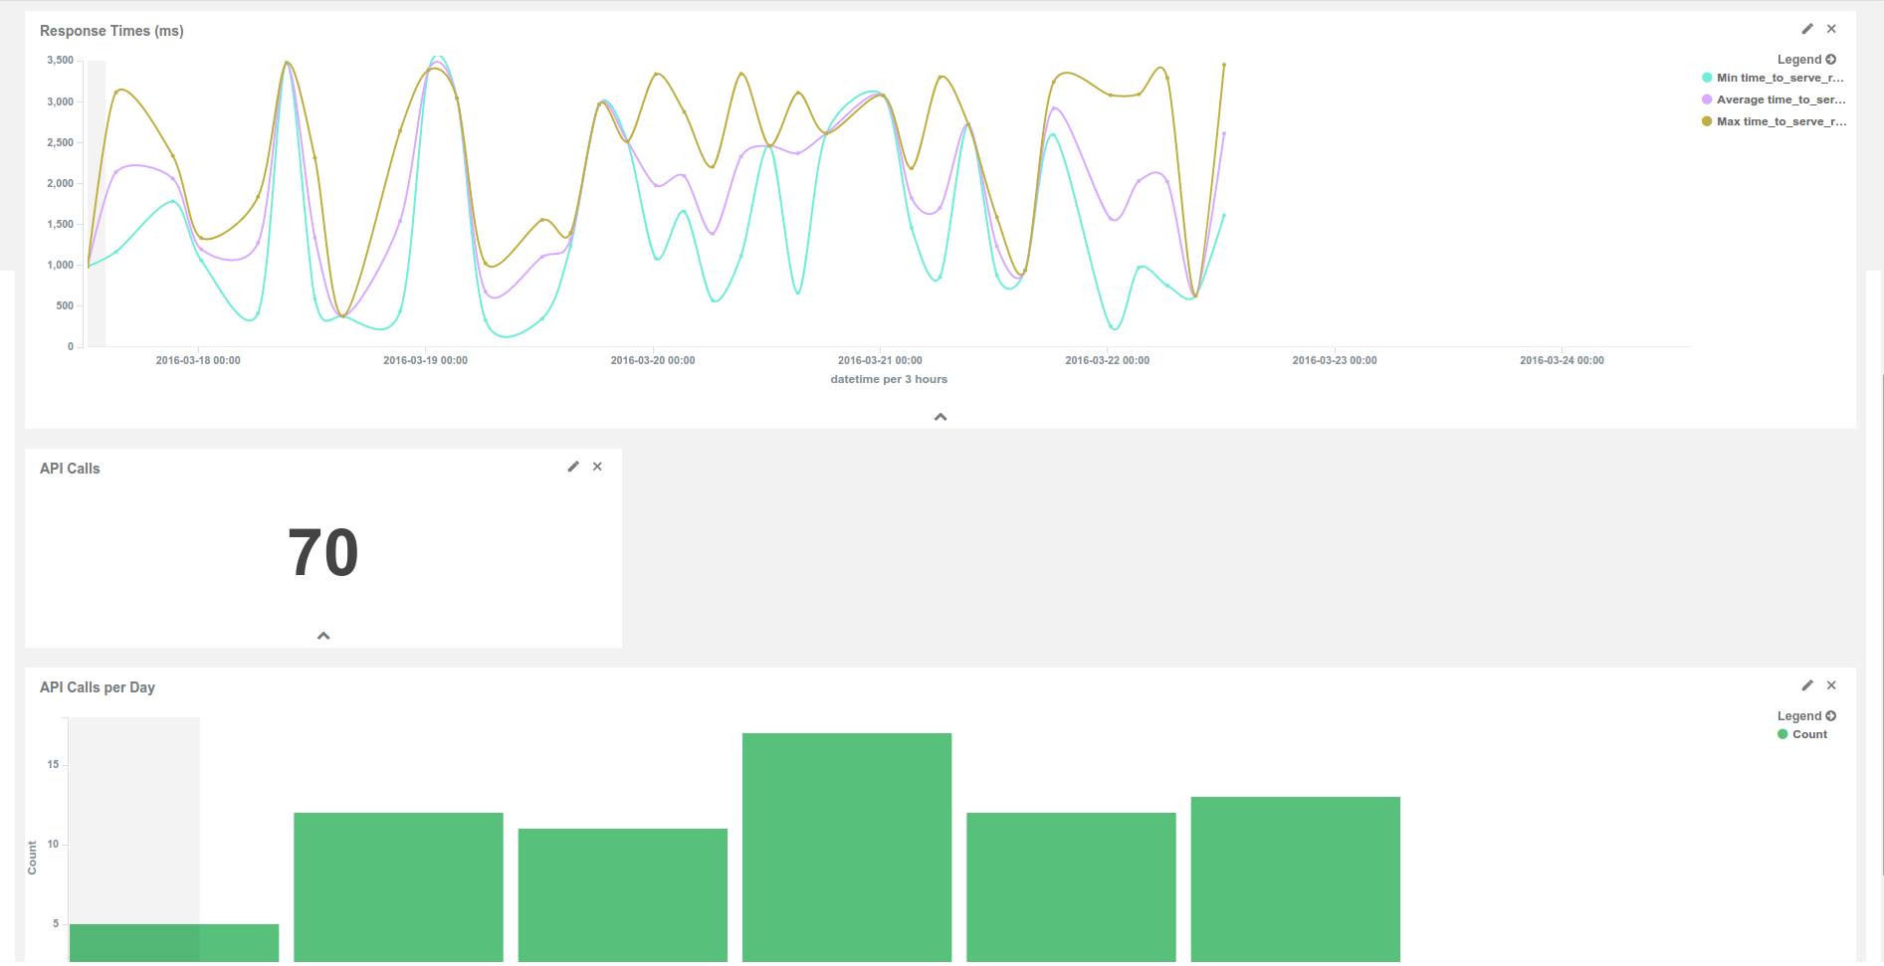
Analyze & Understand API call volume

Slide 57
Developer Portal for API Consumers

Slide 58
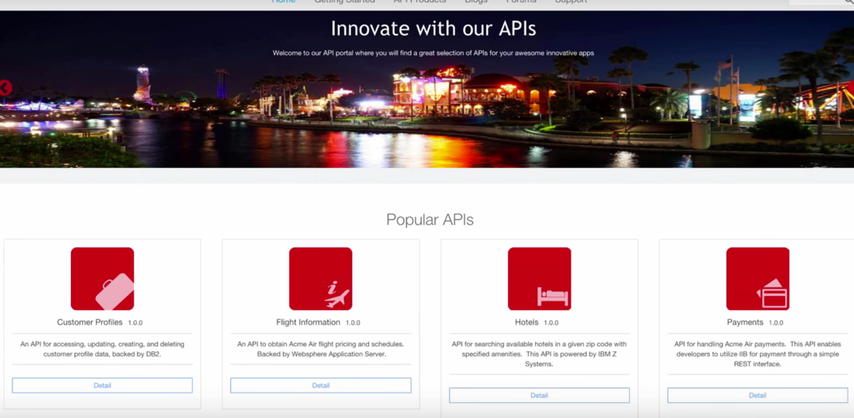
Provide a self-service, company-branded developer portal to your API consumers/subscribers

Slide 59
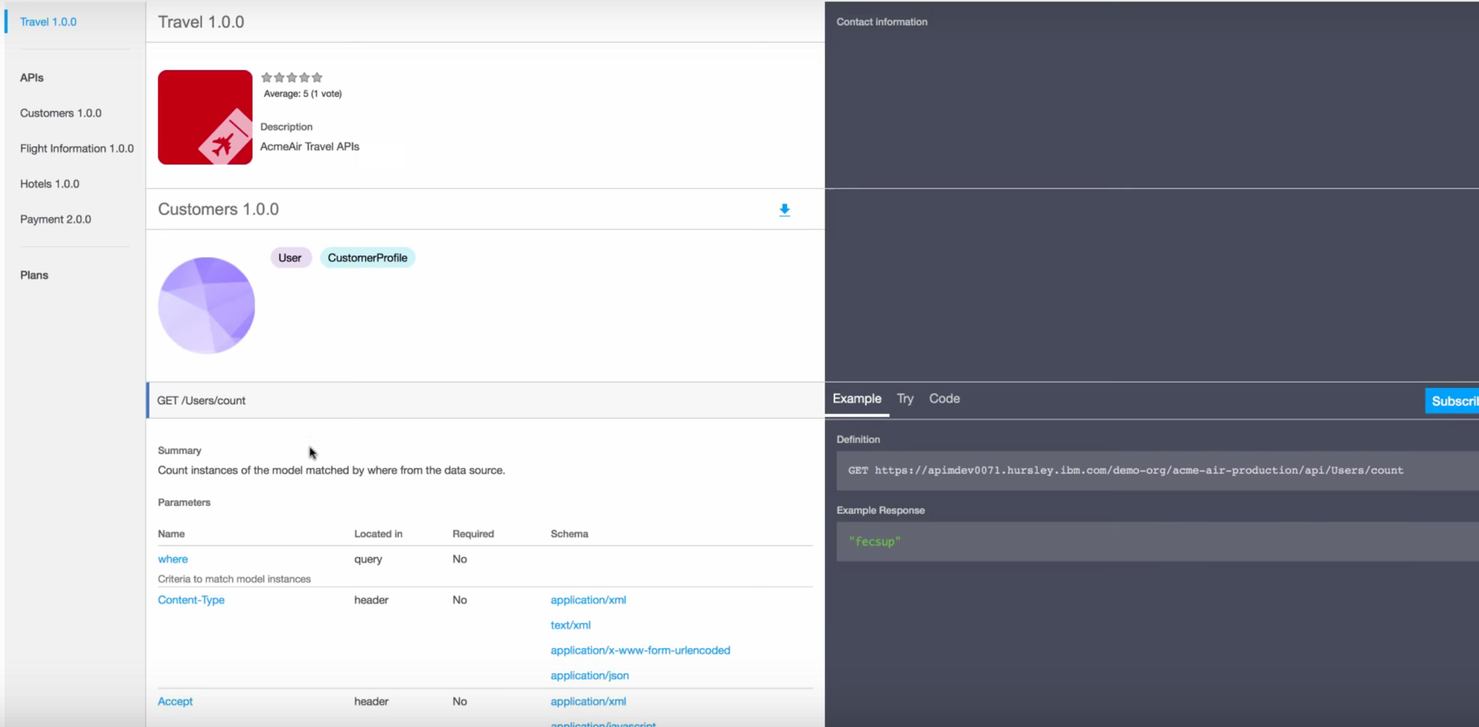
Provide a self-service, company-branded developer portal to your API consumers/subscribers

Slide 60
Manage Environments Cloud Manager

Slide 61
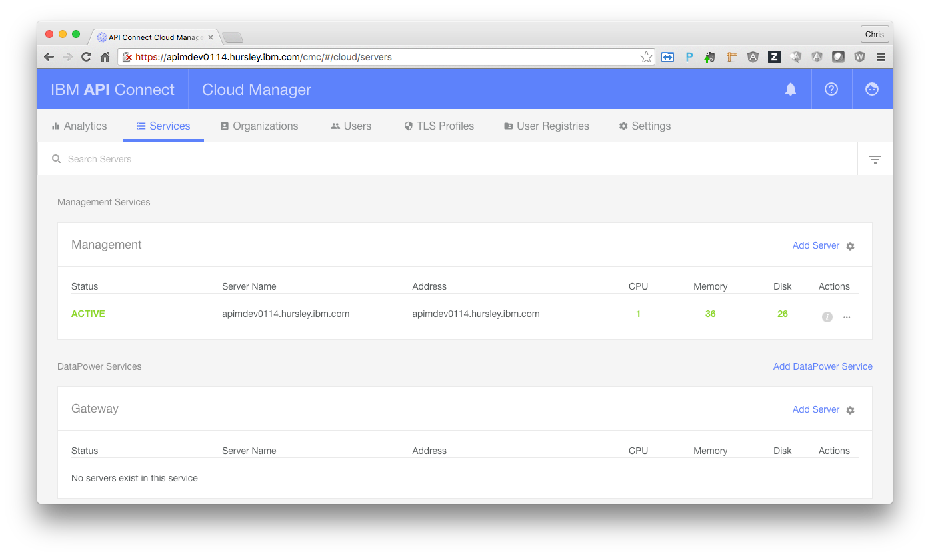
Add & manage cluster members for Management & Gateway service

Slide 62
Monitor the health of Management & Gateway service

Slide 63
Management & Operations of Node.js & Java Microservice Compute Runtimes

Slide 64
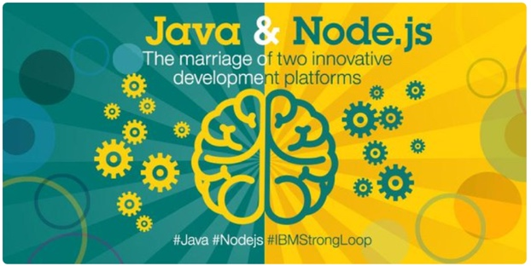





Collectives – Polyglot Runtime Management
web routers
IHS or DP
Node
liberty
liberty
Node
Collectives
controller
Polyglot Runtime Management (Node.js, Liberty (Java)
Unified Console: start, stop, delete applications
Enterprise Clustering & scaling
liberty
liberty
liberty
Strong loop
Node
Unified Management & Operations Console

